Slide 1
LUBBOCK STS
BODY TRANSFORMATION
CHALLENGE

Slide 2
MALE WEIGHT LOSS
(Based solely on Weight Loss %)

Slide 3
HONORABLE MENTION – MALE WEIGHT LOSS
SHEA FLOYD: WEIGHT LOSS % - 8.29%
21.40 LBS. BODY FAT LOSS – 4.60%
KEITH DRONES: WEIGHT LOSS % - 8.39%
21.10 LBS. BODY FAT LOSS – 4.00%
Weight-Loss Claimer: Consumers who use Herbalife® Formula 1 twice per day as part of a healthy lifestyle can generally expect to lose around 0.5 to 1 pound per week. Participants in a 12-week, single-blind study used Formula 1 twice per day (once as a meal and once as a snack) with a reduced- calorie diet and a goal of 30 minutes of exercise per day. Participants followed either a high-protein diet or a standard protein diet. Participants in both groups lost about 8.5 pounds.

Slide 4
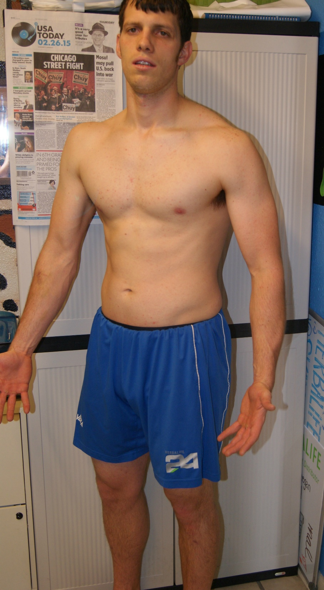
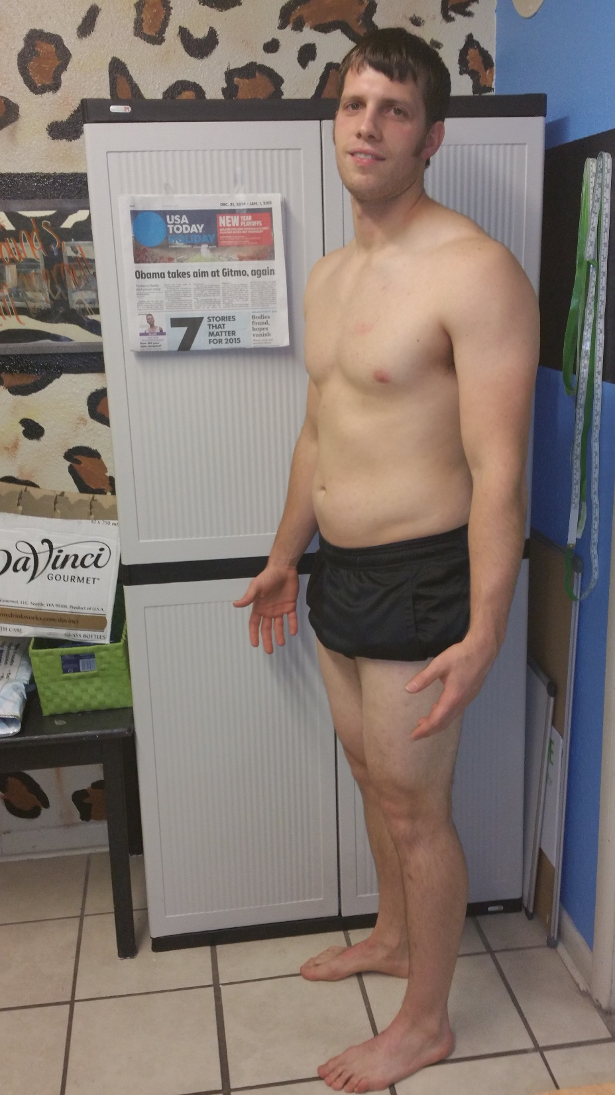
3rd PLACE WEIGHT LOSS
DANIEL RASBAND
WEIGHT LOSS – 21.80 lbs.
WEIGHT LOSS % - 10.28%
BODY FAT LOSS – 2.60%
Weight-Loss Claimer: Consumers who use Herbalife® Formula 1 twice per day as part of a healthy lifestyle can generally expect to lose around 0.5 to 1 pound per week. Participants in a 12-week, single-blind study used Formula 1 twice per day (once as a meal and once as a snack) with a reduced- calorie diet and a goal of 30 minutes of exercise per day. Participants followed either a high-protein diet or a standard protein diet. Participants in both groups lost about 8.5 pounds.

Slide 5
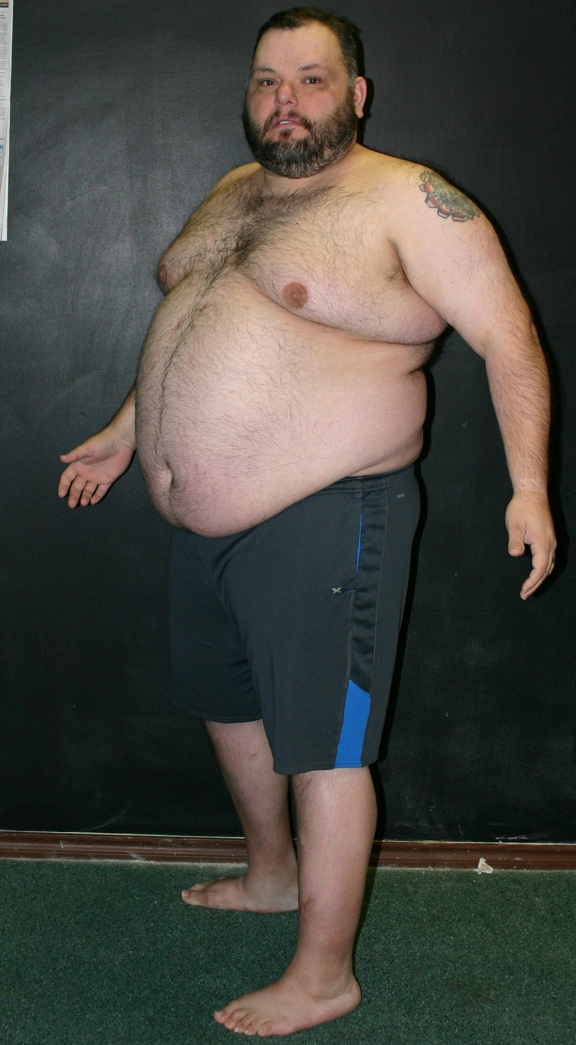
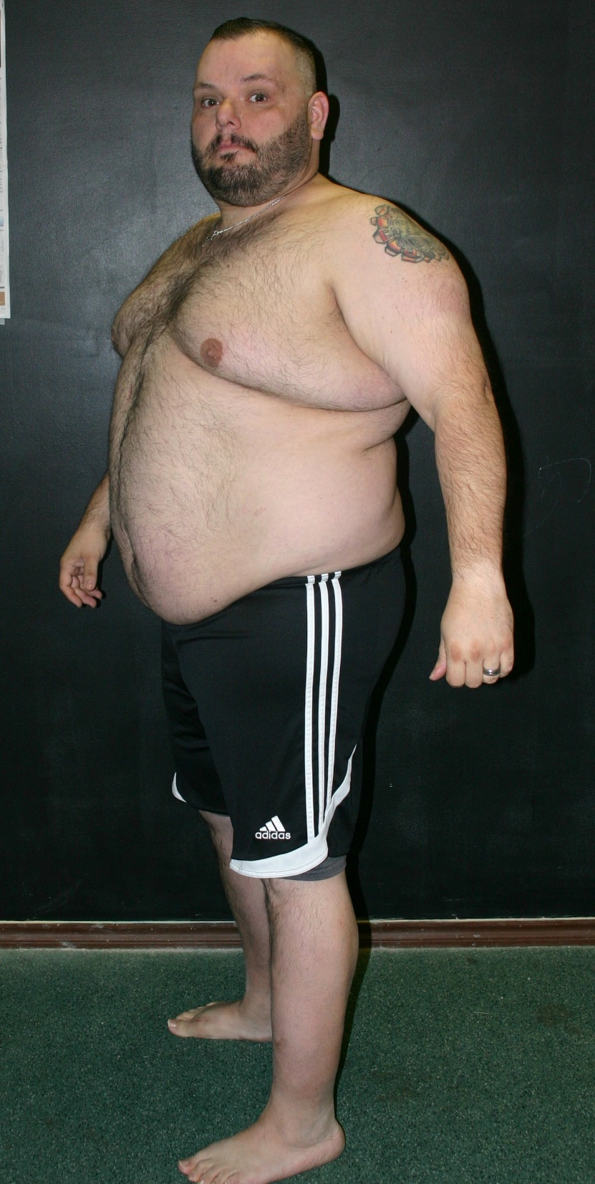
2nd PLACE WEIGHT LOSS
BRIAN PLEASANT
WEIGHT LOSS – 39.00 lbs.
WEIGHT LOSS % - 11.48%
BODY FAT LOSS – 2.00%
Weight-Loss Claimer: Consumers who use Herbalife® Formula 1 twice per day as part of a healthy lifestyle can generally expect to lose around 0.5 to 1 pound per week. Participants in a 12-week, single-blind study used Formula 1 twice per day (once as a meal and once as a snack) with a reduced- calorie diet and a goal of 30 minutes of exercise per day. Participants followed either a high-protein diet or a standard protein diet. Participants in both groups lost about 8.5 pounds.

Slide 6
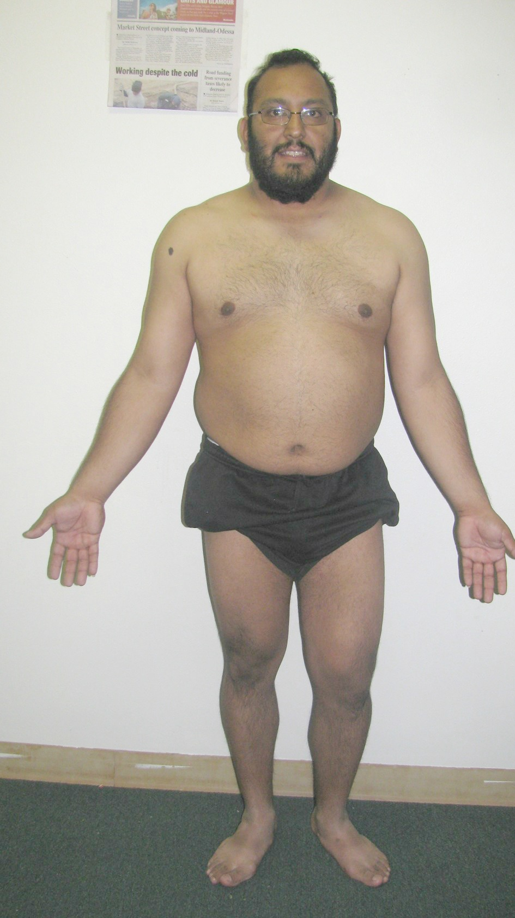
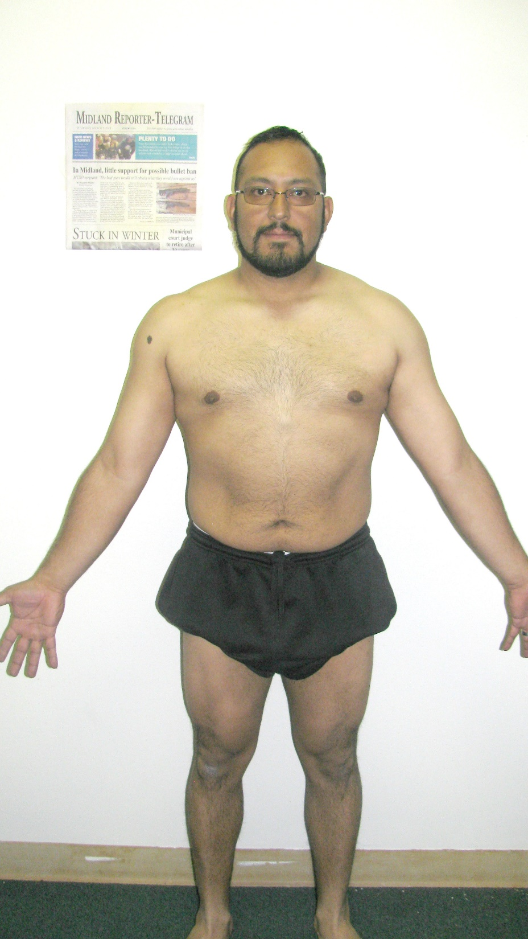
1st PLACE WEIGHT LOSS
FIDEL RAMOS
WEIGHT LOSS – 29.40 lbs.
WEIGHT LOSS % - 13.40%
BODY FAT LOSS – 8.30%
Weight-Loss Claimer: Consumers who use Herbalife® Formula 1 twice per day as part of a healthy lifestyle can generally expect to lose around 0.5 to 1 pound per week. Participants in a 12-week, single-blind study used Formula 1 twice per day (once as a meal and once as a snack) with a reduced- calorie diet and a goal of 30 minutes of exercise per day. Participants followed either a high-protein diet or a standard protein diet. Participants in both groups lost about 8.5 pounds.

Slide 7
BTC - MARCH 2015
FEMALE WEIGHT LOSS
(Based solely on Weight Loss %)

Slide 8
HONORABLE MENTION – FEMALE WEIGHT LOSS
DELIA CASTILLO – WEIGHT LOSS % - 9.42%
16.20 LBS. BODY FAT LOSS – 3.00%
LAURA BETH PLEASANT – WEIGHT LOSS % - 10.33%
21.60 LBS. BODY FAT LOSS – 3.90%
Weight-Loss Claimer: Consumers who use Herbalife® Formula 1 twice per day as part of a healthy lifestyle can generally expect to lose around 0.5 to 1 pound per week. Participants in a 12-week, single-blind study used Formula 1 twice per day (once as a meal and once as a snack) with a reduced- calorie diet and a goal of 30 minutes of exercise per day. Participants followed either a high-protein diet or a standard protein diet. Participants in both groups lost about 8.5 pounds.

Slide 9
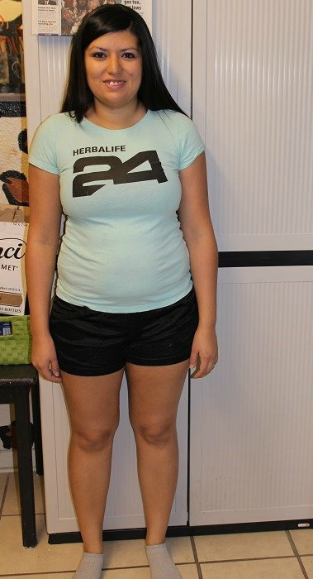
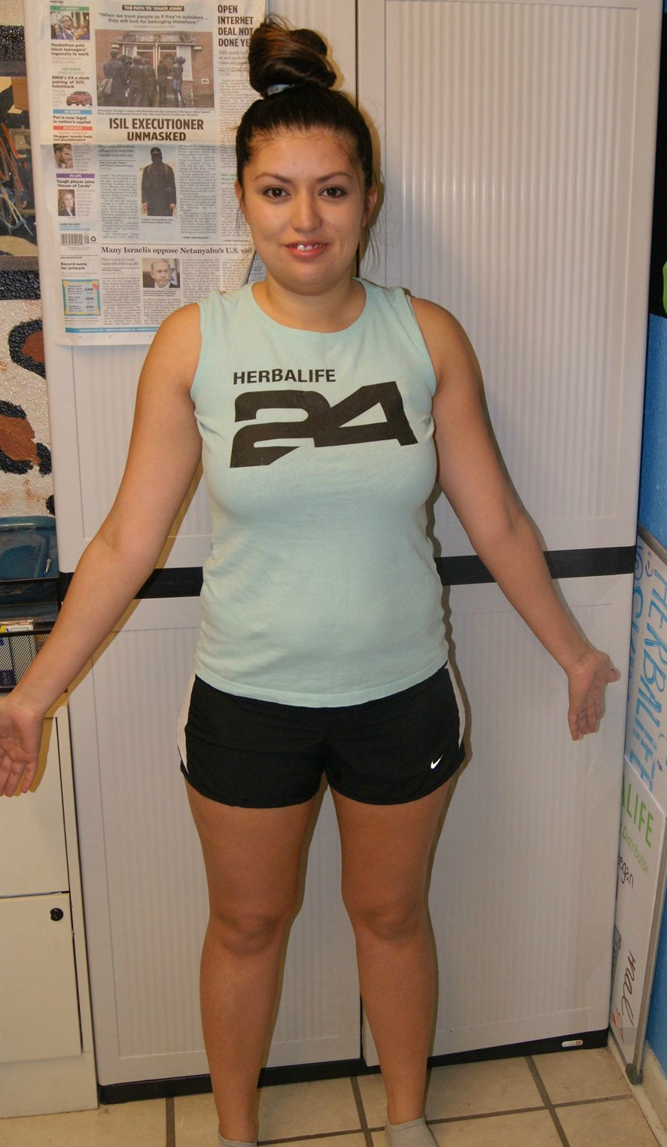
3RD PLACE WEIGHT LOSS
BRENDA BUFKIN
WEIGHT LOSS – 16.80 lbs.
WEIGHT LOSS % - 11.52%
BODY FAT LOSS – 4.40%
Weight-Loss Claimer: Consumers who use Herbalife® Formula 1 twice per day as part of a healthy lifestyle can generally expect to lose around 0.5 to 1 pound per week. Participants in a 12-week, single-blind study used Formula 1 twice per day (once as a meal and once as a snack) with a reduced- calorie diet and a goal of 30 minutes of exercise per day. Participants followed either a high-protein diet or a standard protein diet. Participants in both groups lost about 8.5 pounds.

Slide 10
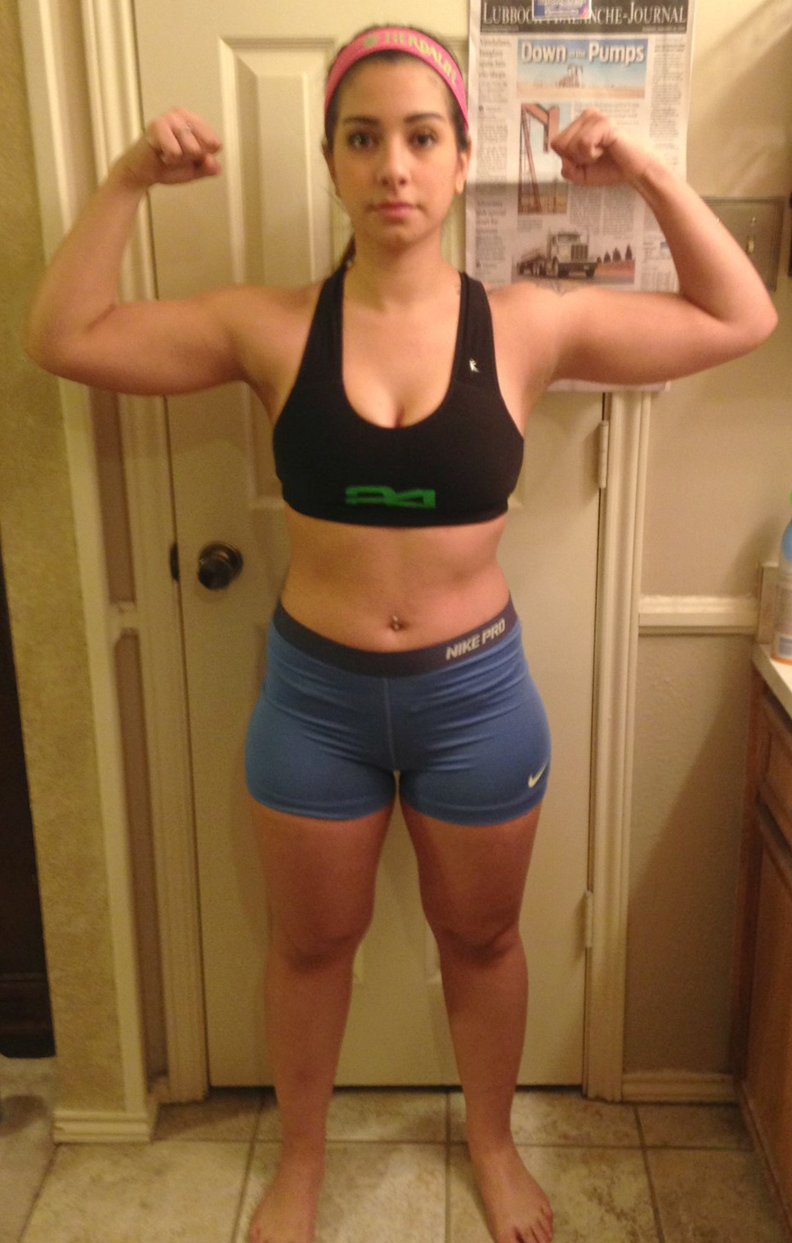
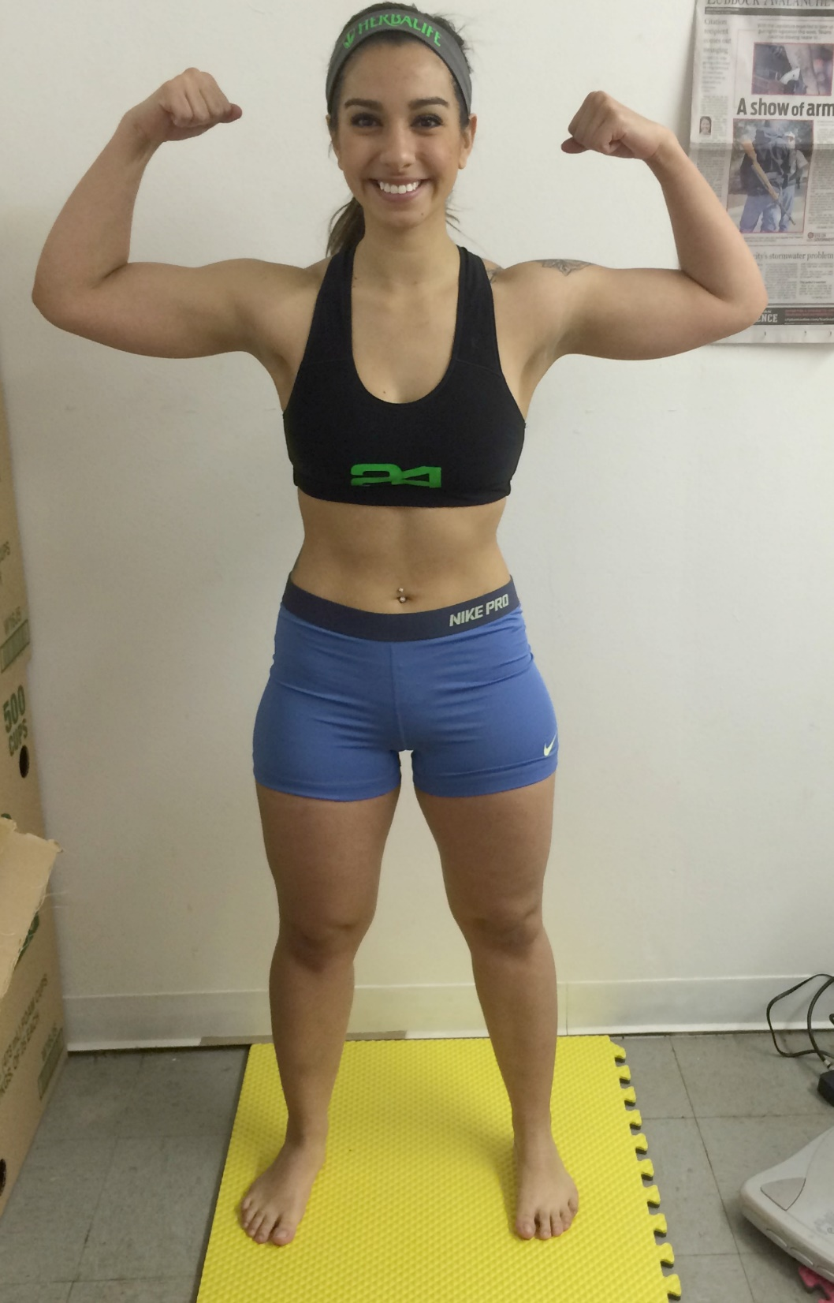
2ND PLACE WEIGHT LOSS
NICOLE ALVIDREZ
WEIGHT LOSS – 18.00 lbs.
WEIGHT LOSS % - 11.92%
BODY FAT LOSS – 5.30%
Weight-Loss Claimer: Consumers who use Herbalife® Formula 1 twice per day as part of a healthy lifestyle can generally expect to lose around 0.5 to 1 pound per week. Participants in a 12-week, single-blind study used Formula 1 twice per day (once as a meal and once as a snack) with a reduced- calorie diet and a goal of 30 minutes of exercise per day. Participants followed either a high-protein diet or a standard protein diet. Participants in both groups lost about 8.5 pounds.

Slide 11
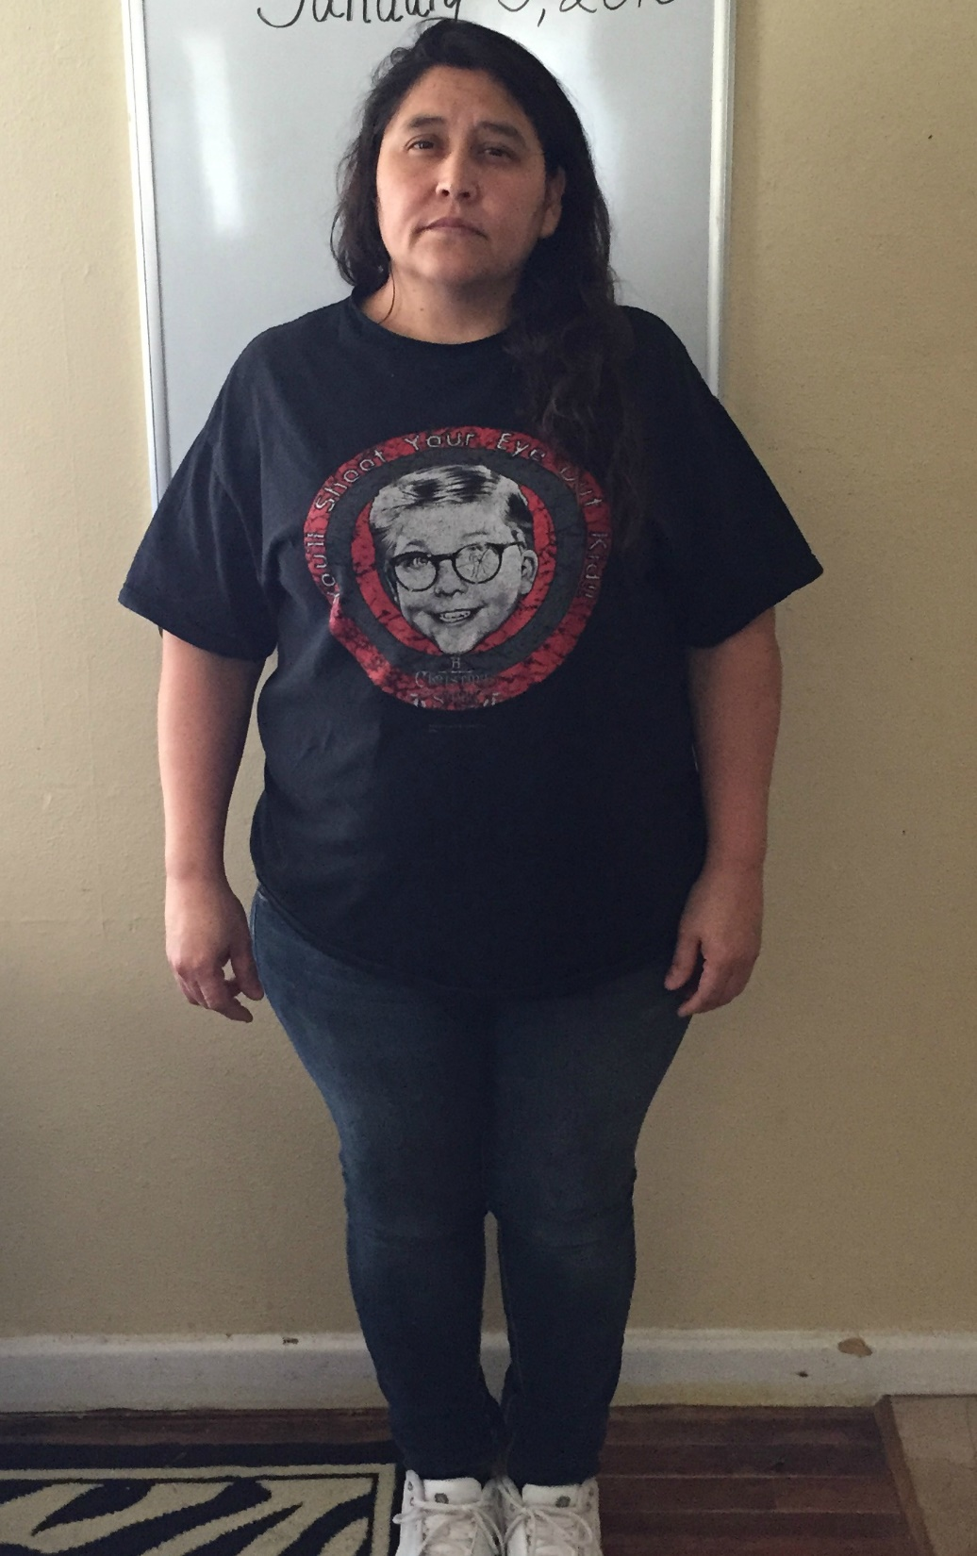
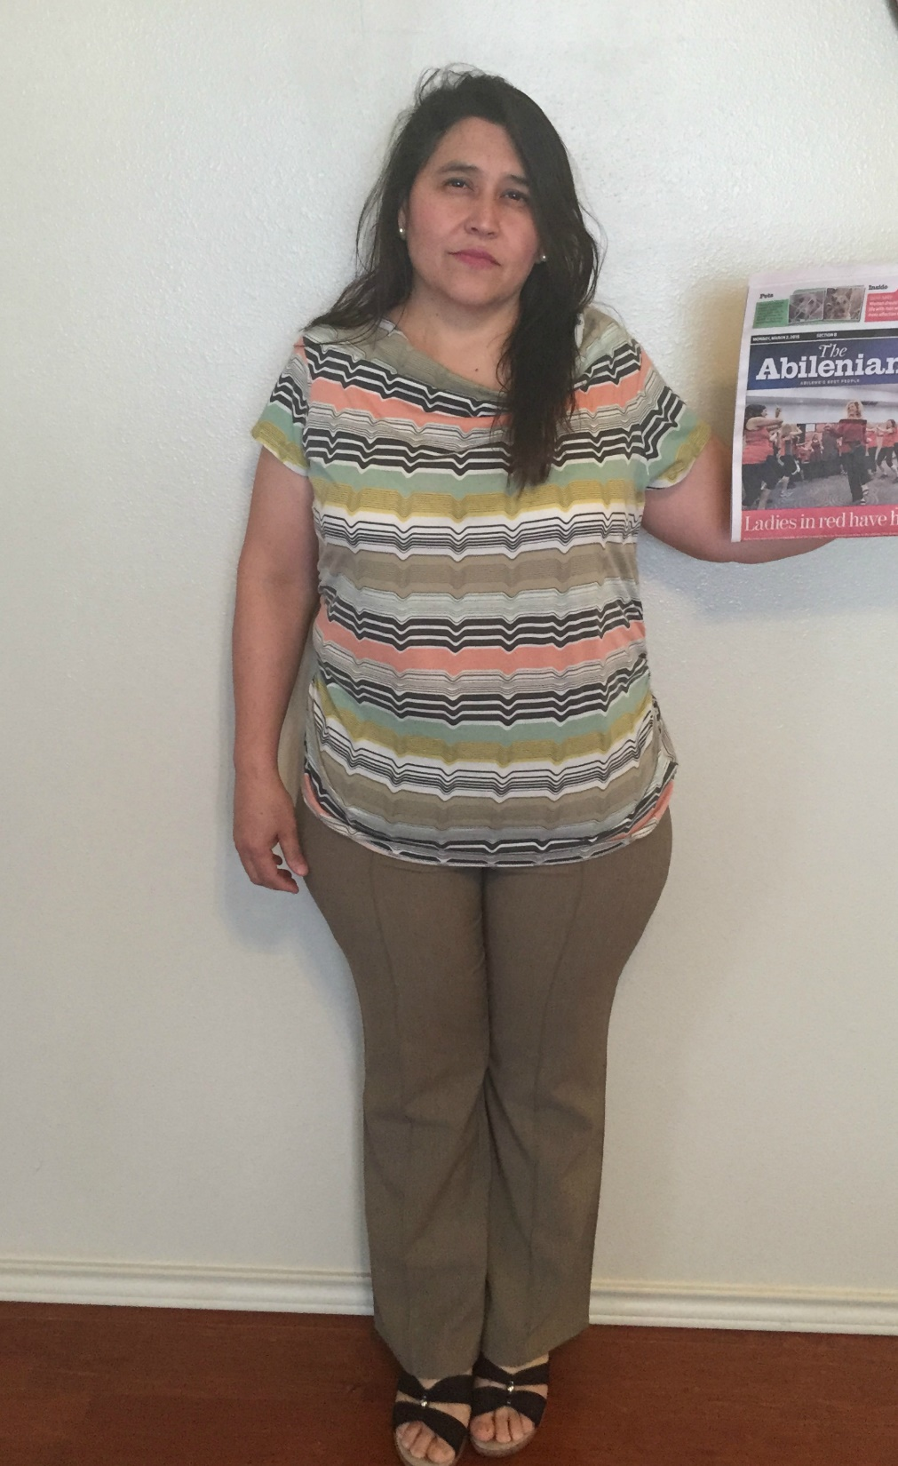
1st PLACE WEIGHT LOSS
VIRGINIA HERNANDEZ
WEIGHT LOSS – 26.60lbs.
WEIGHT LOSS % - 13.09%
BODY FAT LOSS – .70%
Weight-Loss Claimer: Consumers who use Herbalife® Formula 1 twice per day as part of a healthy lifestyle can generally expect to lose around 0.5 to 1 pound per week. Participants in a 12-week, single-blind study used Formula 1 twice per day (once as a meal and once as a snack) with a reduced- calorie diet and a goal of 30 minutes of exercise per day. Participants followed either a high-protein diet or a standard protein diet. Participants in both groups lost about 8.5 pounds.

Slide 12
BTC - MARCH 2015
OVER 40 TRANSFORMATION - FEMALE

Slide 13
HONORABLE MENTION – FEMALE OVER 40 TRANSFORMATION
DIANA NEIGHLY: WEIGHT LOSS % - 3.93%
6.30 LBS. BODY FAT LOSS – 1.30%
JENNIFER LANGWELL: WEIGHT LOSS % - .14%
.20 LBS. BODY FAT LOSS – 3.60%
Weight-Loss Claimer: Consumers who use Herbalife® Formula 1 twice per day as part of a healthy lifestyle can generally expect to lose around 0.5 to 1 pound per week. Participants in a 12-week, single-blind study used Formula 1 twice per day (once as a meal and once as a snack) with a reduced- calorie diet and a goal of 30 minutes of exercise per day. Participants followed either a high-protein diet or a standard protein diet. Participants in both groups lost about 8.5 pounds.

Slide 14
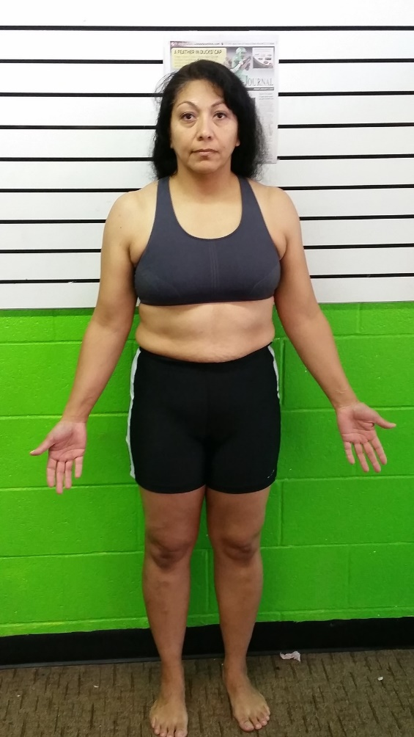
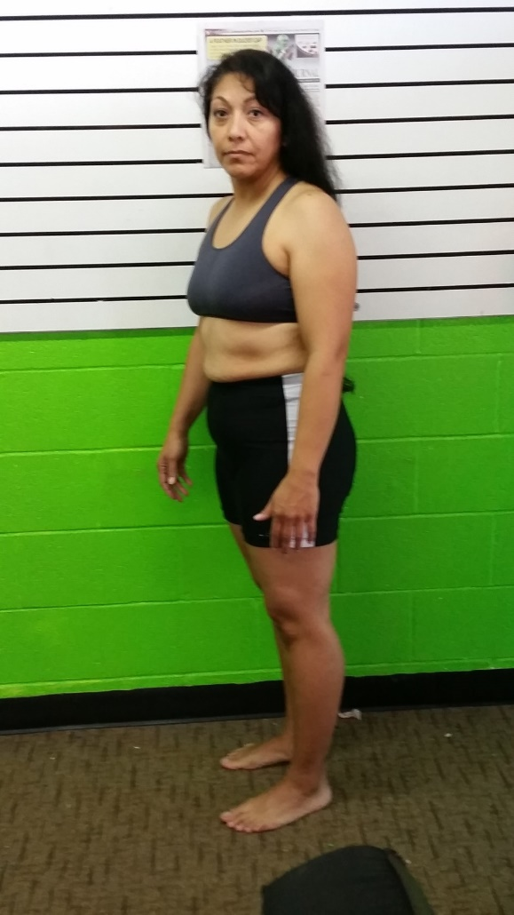
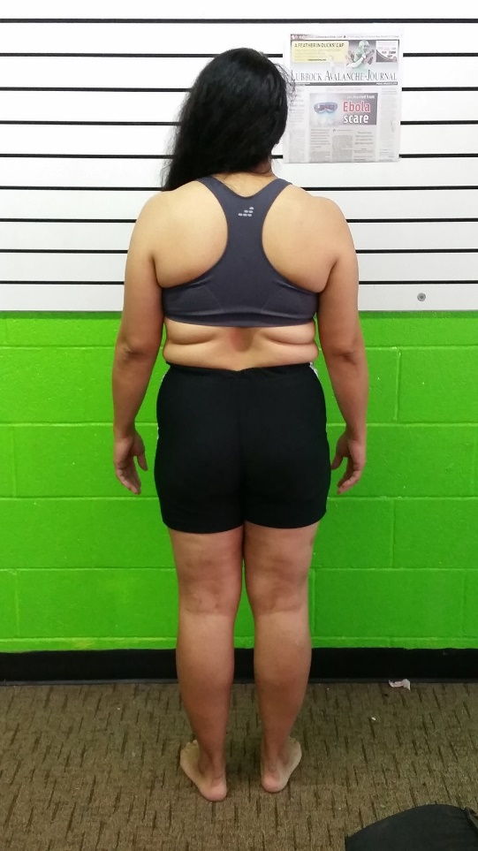
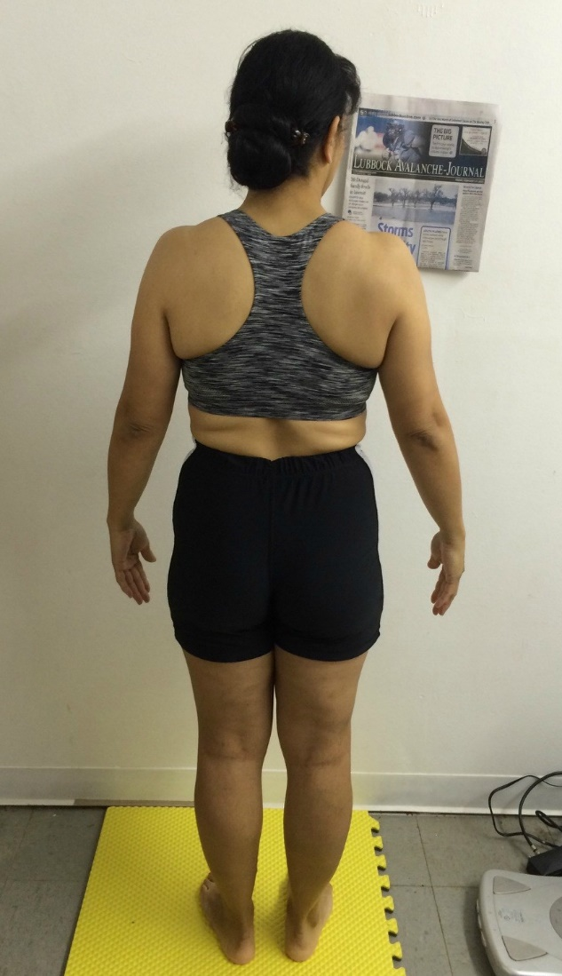
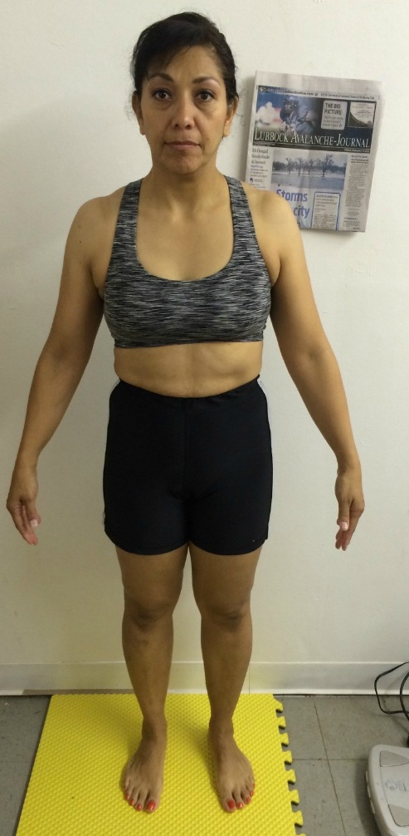
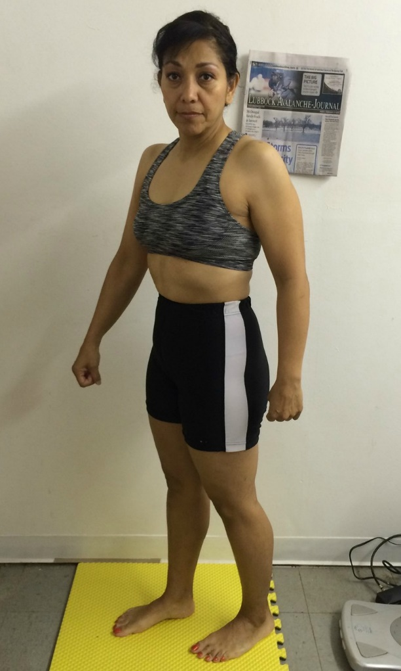
KATHY ENRIQUEZ
3RD PLACE
OVER 40 TRAMSFORMATION
Weight-Loss Claimer: Consumers who use Herbalife® Formula 1 twice per day as part of a healthy lifestyle can generally expect to lose around 0.5 to 1 pound per week. Participants in a 12-week, single-blind study used Formula 1 twice per day (once as a meal and once as a snack) with a reduced- calorie diet and a goal of 30 minutes of exercise per day. Participants followed either a high-protein diet or a standard protein diet. Participants in both groups lost about 8.5 pounds.

Slide 15
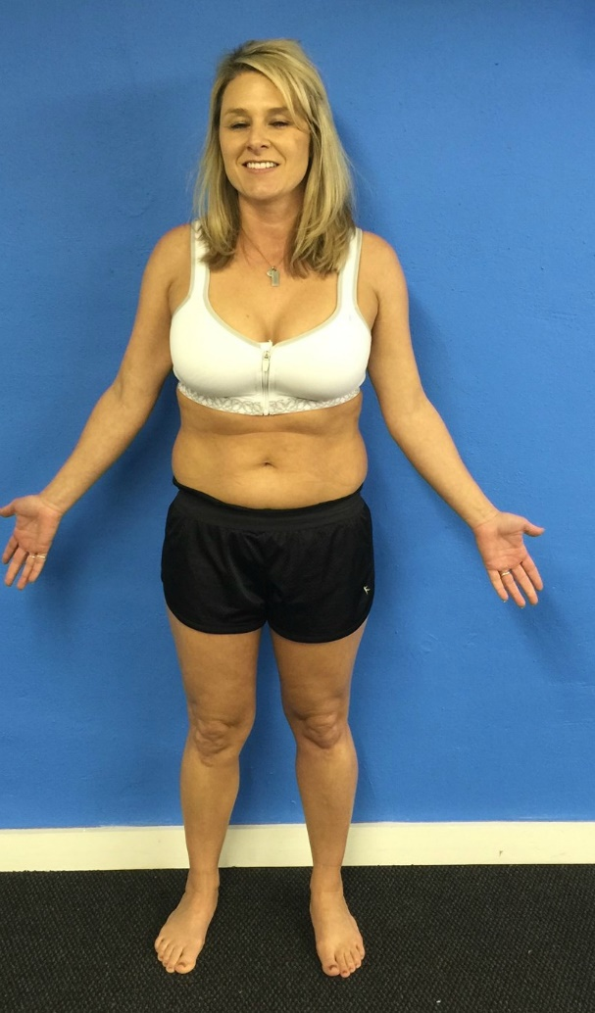
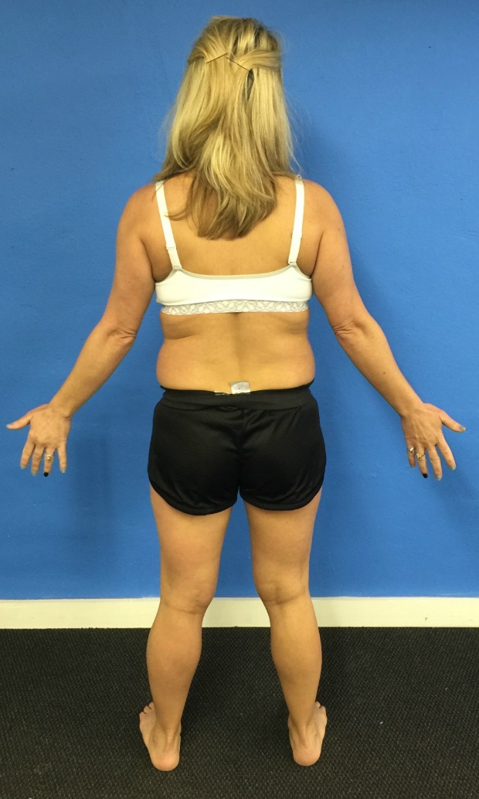
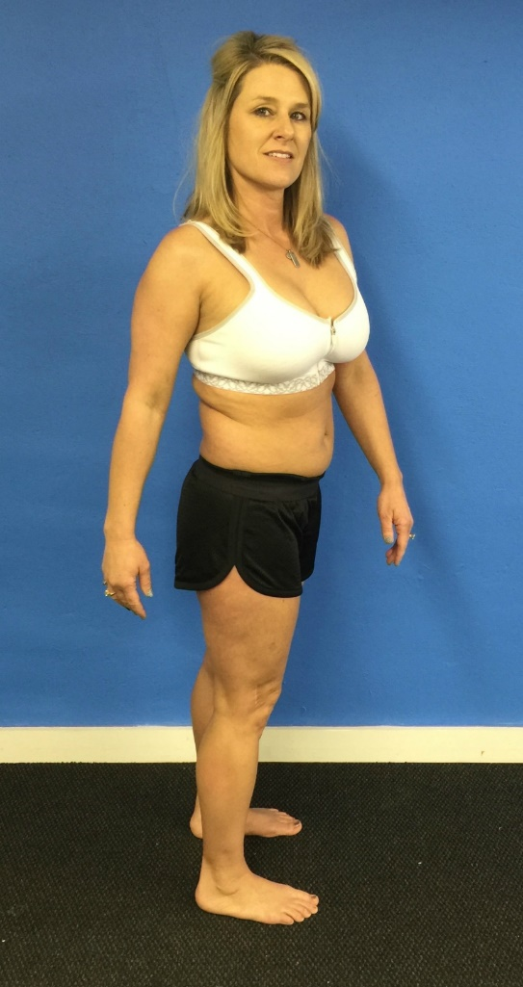
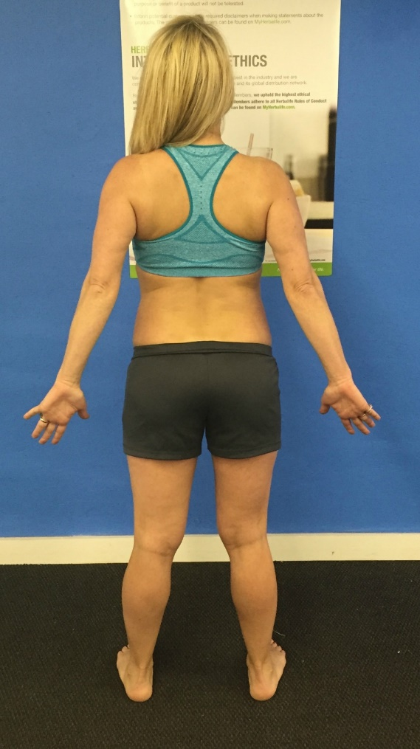
ANGELA FLOYD
2ND PLACE
OVER 40 TRAMSFORMATION
Weight-Loss Claimer: Consumers who use Herbalife® Formula 1 twice per day as part of a healthy lifestyle can generally expect to lose around 0.5 to 1 pound per week. Participants in a 12-week, single-blind study used Formula 1 twice per day (once as a meal and once as a snack) with a reduced- calorie diet and a goal of 30 minutes of exercise per day. Participants followed either a high-protein diet or a standard protein diet. Participants in both groups lost about 8.5 pounds.

Slide 16
LIBBY CLARK 1ST PLACE
OVER 40 TRAMSFORMATION
Weight-Loss Claimer: Consumers who use Herbalife® Formula 1 twice per day as part of a healthy lifestyle can generally expect to lose around 0.5 to 1 pound per week. Participants in a 12-week, single-blind study used Formula 1 twice per day (once as a meal and once as a snack) with a reduced- calorie diet and a goal of 30 minutes of exercise per day. Participants followed either a high-protein diet or a standard protein diet. Participants in both groups lost about 8.5 pounds.

Slide 17
BTC - MARCH 2015
OVER 40 TRANSFORMATION - MALE

Slide 18
HONORABLE MENTION – MALE OVER 40 TRANSFORMATION
KENNETH KING – WEIGHT LOSS % 2.98
6.00 LBS. BODY FAT LOSS – 4.00%
CARLOS ALVAREZ – WEIGHT LOSS % 2.84
4.40 LBS. BODY FAT LOSS – 1.50%
Weight-Loss Claimer: Consumers who use Herbalife® Formula 1 twice per day as part of a healthy lifestyle can generally expect to lose around 0.5 to 1 pound per week. Participants in a 12-week, single-blind study used Formula 1 twice per day (once as a meal and once as a snack) with a reduced- calorie diet and a goal of 30 minutes of exercise per day. Participants followed either a high-protein diet or a standard protein diet. Participants in both groups lost about 8.5 pounds.

Slide 19
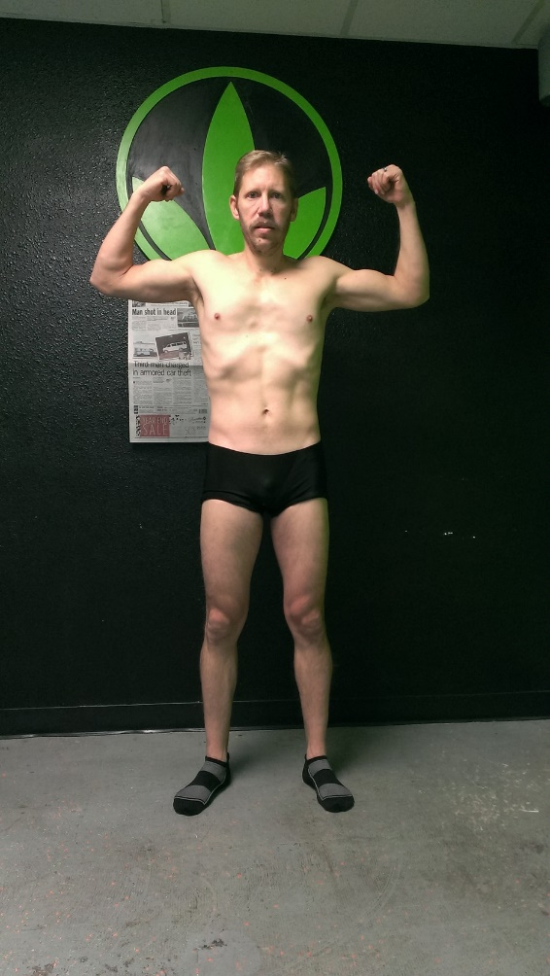
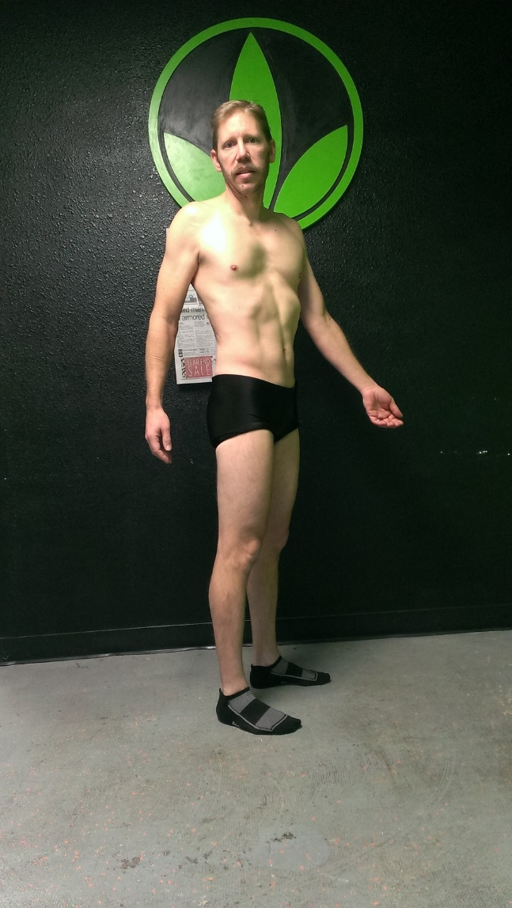
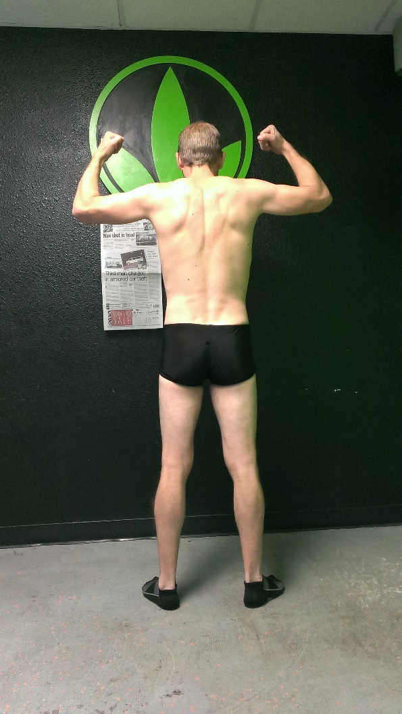
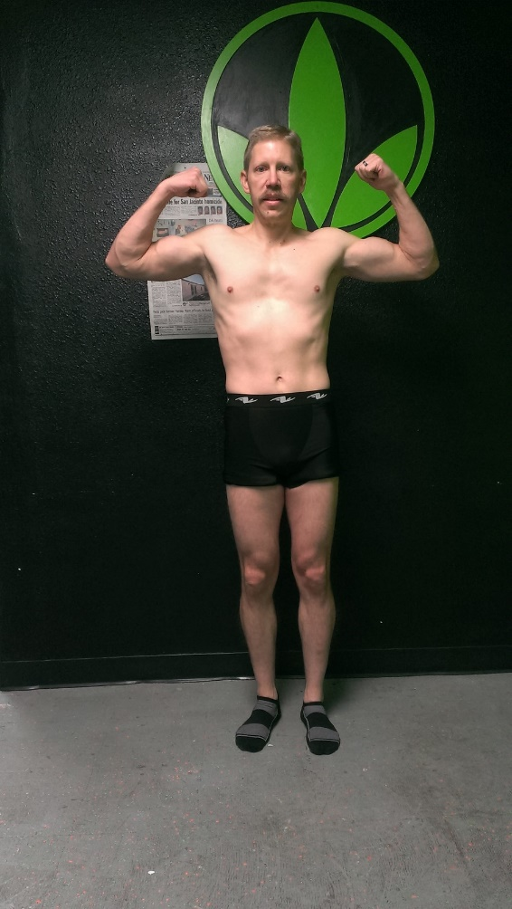
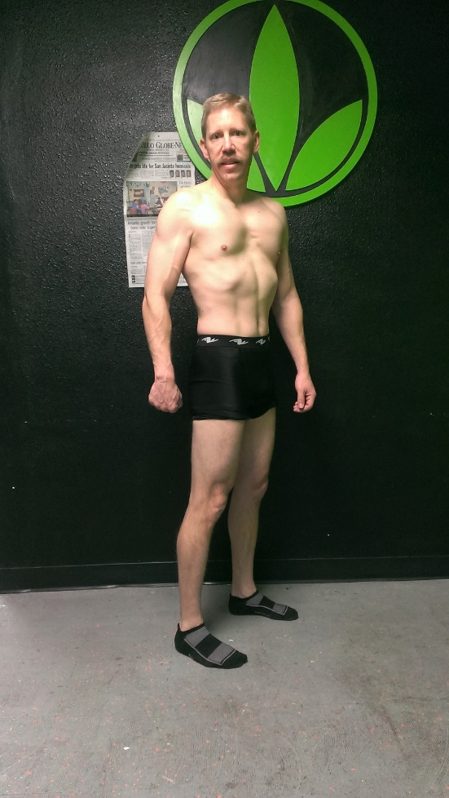
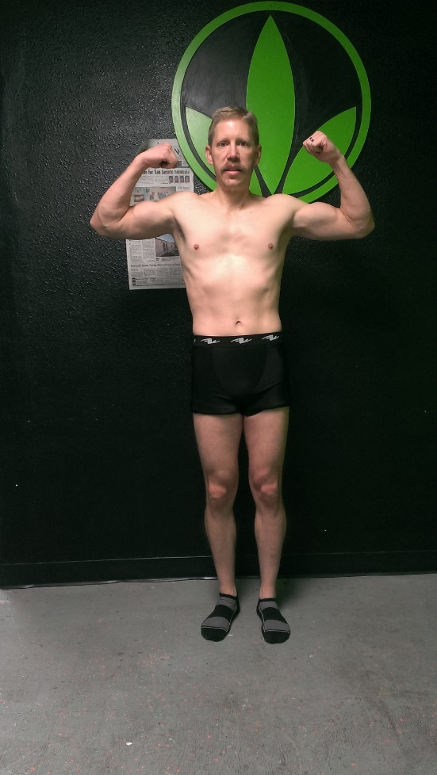
BLAIR SCHAFFER 3RD PLACE
OVER 40 TRAMSFORMATION
MALE
Weight-Loss Claimer: Consumers who use Herbalife® Formula 1 twice per day as part of a healthy lifestyle can generally expect to lose around 0.5 to 1 pound per week. Participants in a 12-week, single-blind study used Formula 1 twice per day (once as a meal and once as a snack) with a reduced- calorie diet and a goal of 30 minutes of exercise per day. Participants followed either a high-protein diet or a standard protein diet. Participants in both groups lost about 8.5 pounds.

Slide 20
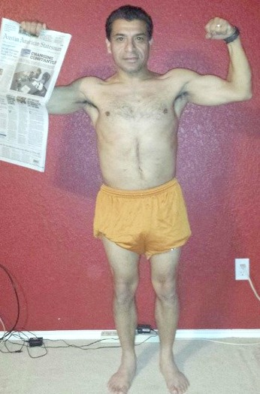
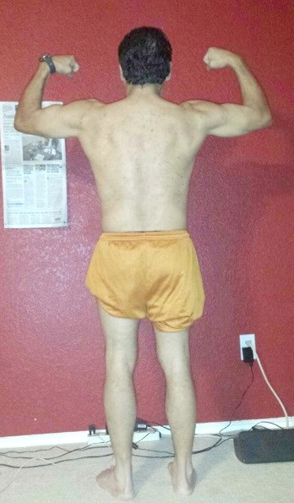
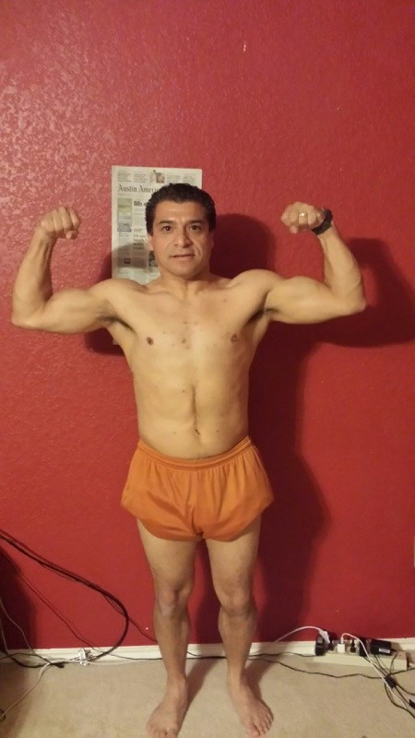
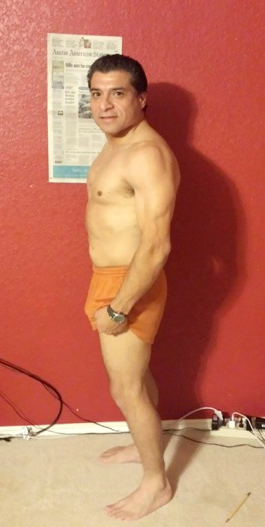
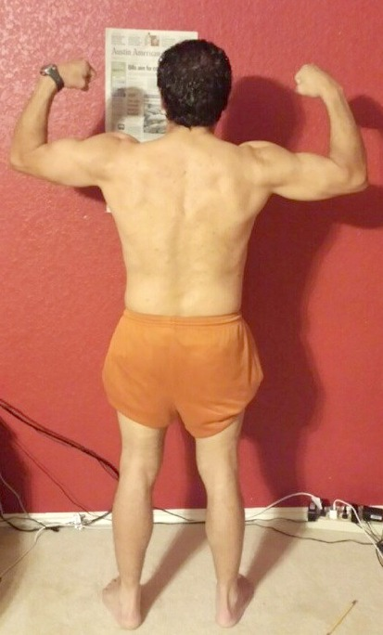
ROBERT HENRY 2ND PLACE
OVER 40 TRAMSFORMATION
MALE
Weight-Loss Claimer: Consumers who use Herbalife® Formula 1 twice per day as part of a healthy lifestyle can generally expect to lose around 0.5 to 1 pound per week. Participants in a 12-week, single-blind study used Formula 1 twice per day (once as a meal and once as a snack) with a reduced- calorie diet and a goal of 30 minutes of exercise per day. Participants followed either a high-protein diet or a standard protein diet. Participants in both groups lost about 8.5 pounds.

Slide 21
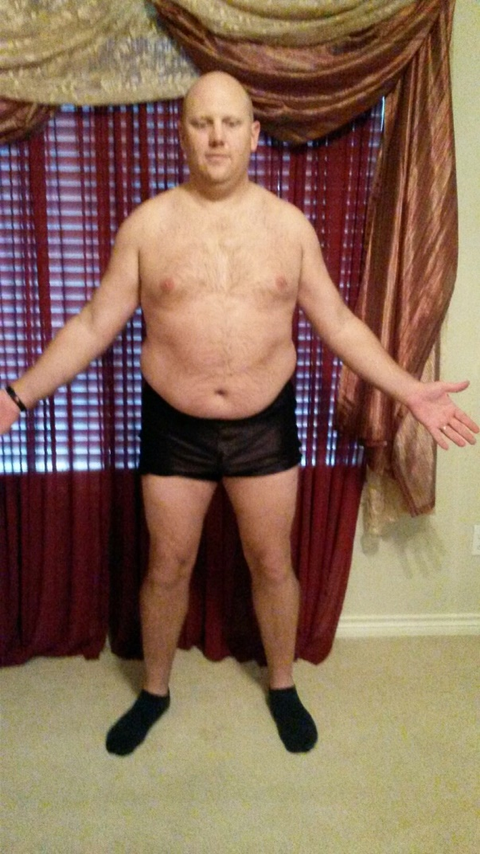
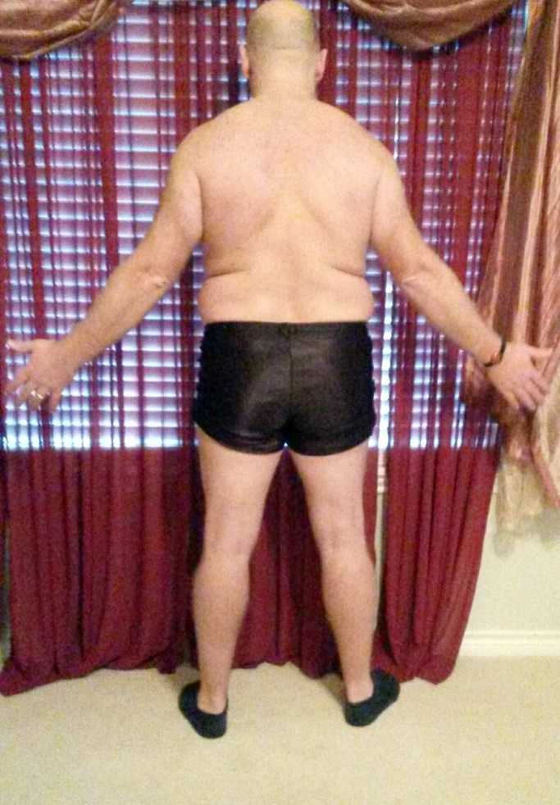
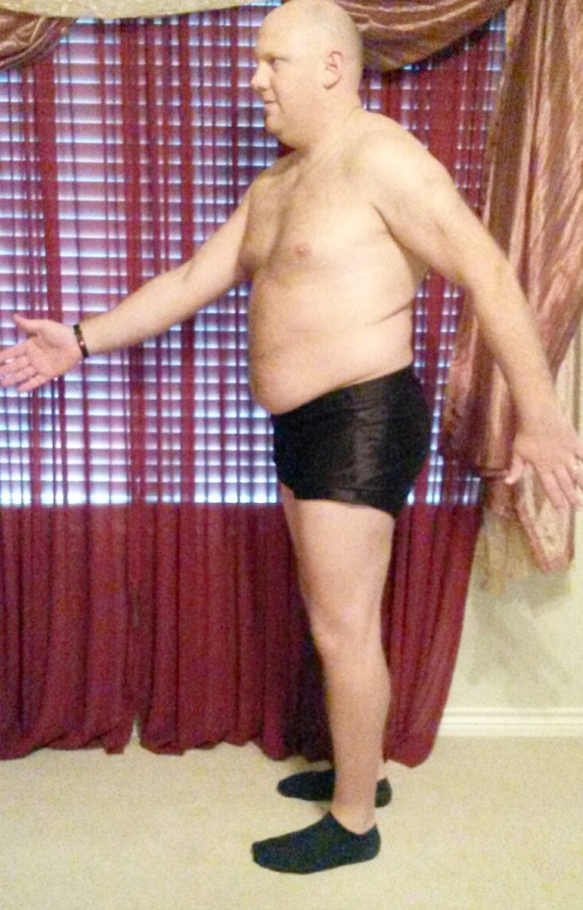
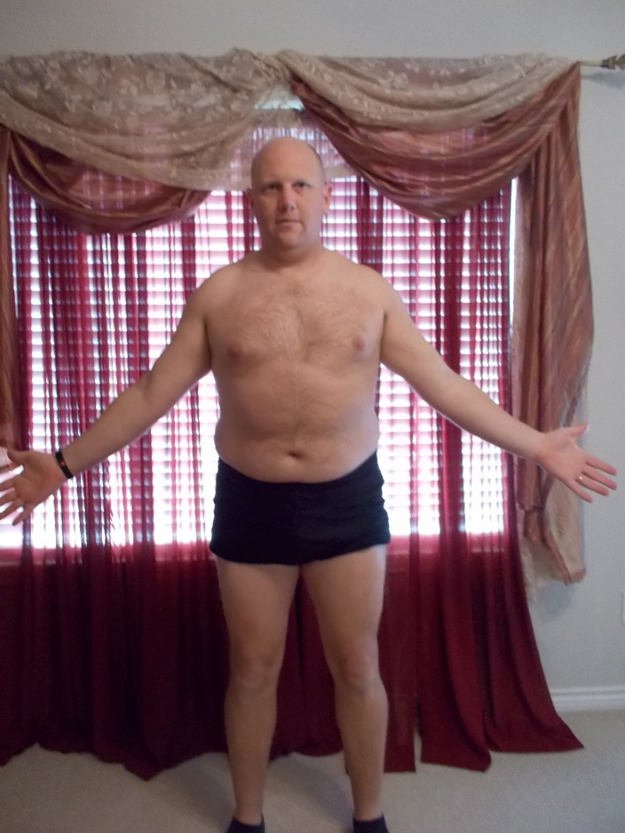
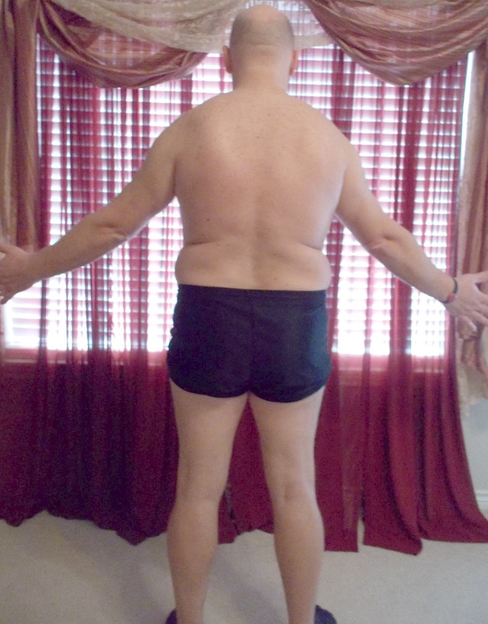
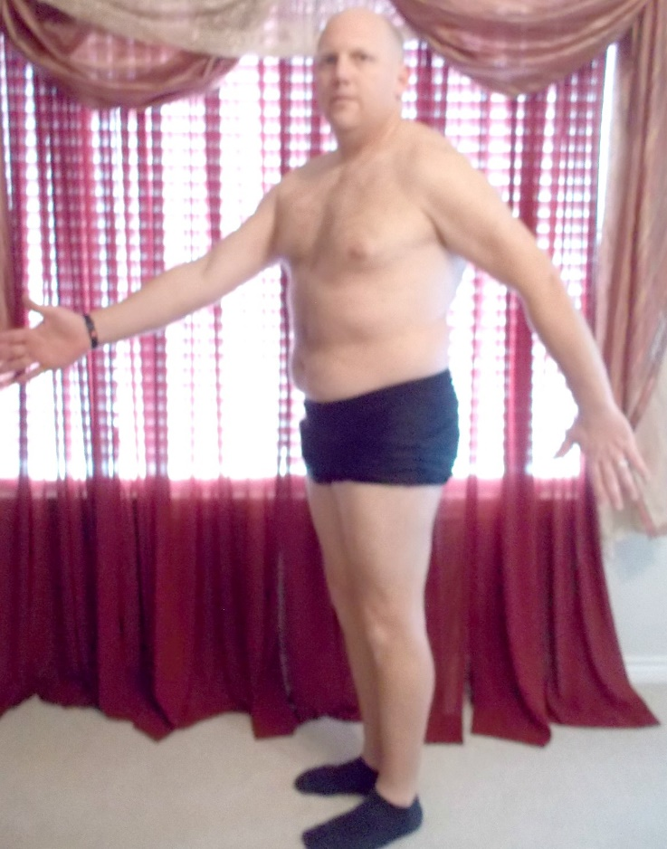
SAMUEL SHERMAN 1ST PLACE
OVER 40 TRAMSFORMATION
MALE
Weight-Loss Claimer: Consumers who use Herbalife® Formula 1 twice per day as part of a healthy lifestyle can generally expect to lose around 0.5 to 1 pound per week. Participants in a 12-week, single-blind study used Formula 1 twice per day (once as a meal and once as a snack) with a reduced- calorie diet and a goal of 30 minutes of exercise per day. Participants followed either a high-protein diet or a standard protein diet. Participants in both groups lost about 8.5 pounds.

Slide 22
BTC - MARCH 2015
FEMALE TRANSFORMATION

Slide 23
HONORABLE MENTION – FEMALE TRANSFORMATION
CATLIN STEHIK: WEIGHT LOSS % - 8.36%
22.30 LBS. BODY FAT LOSS – 3.60%
LORENA POSADAS: WEIGHT LOSS % - 6.64%
8.60 LBS. BODY FAT LOSS – 3.60%
Weight-Loss Claimer: Consumers who use Herbalife® Formula 1 twice per day as part of a healthy lifestyle can generally expect to lose around 0.5 to 1 pound per week. Participants in a 12-week, single-blind study used Formula 1 twice per day (once as a meal and once as a snack) with a reduced- calorie diet and a goal of 30 minutes of exercise per day. Participants followed either a high-protein diet or a standard protein diet. Participants in both groups lost about 8.5 pounds.

Slide 24
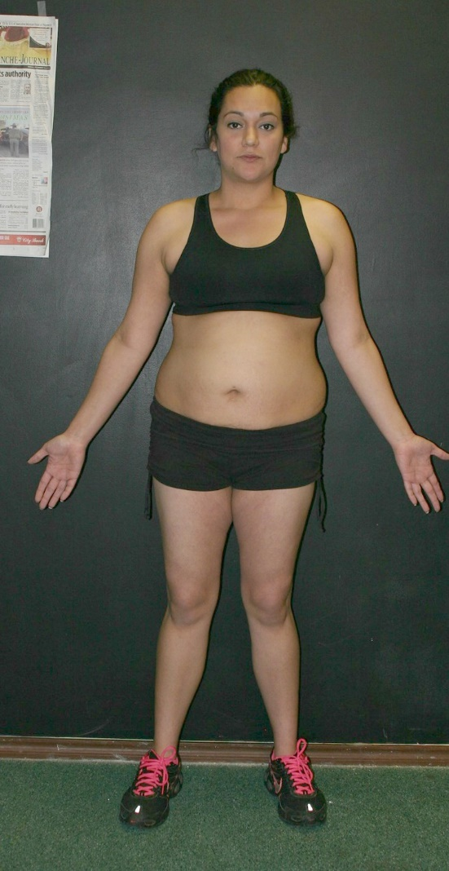
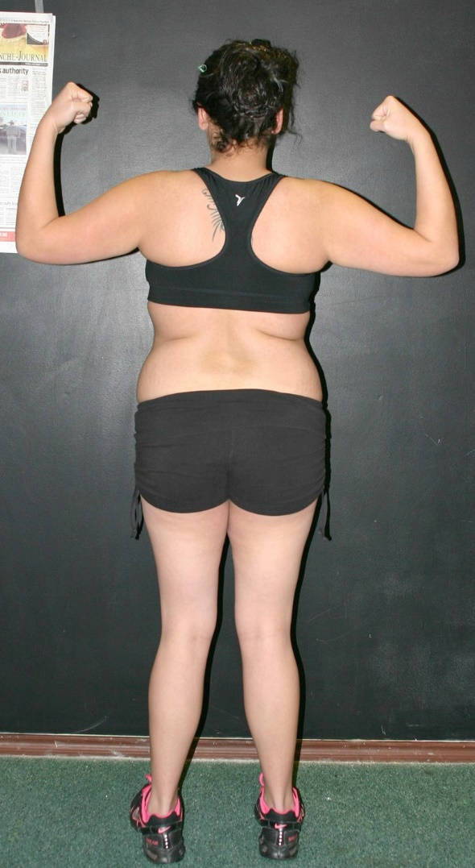
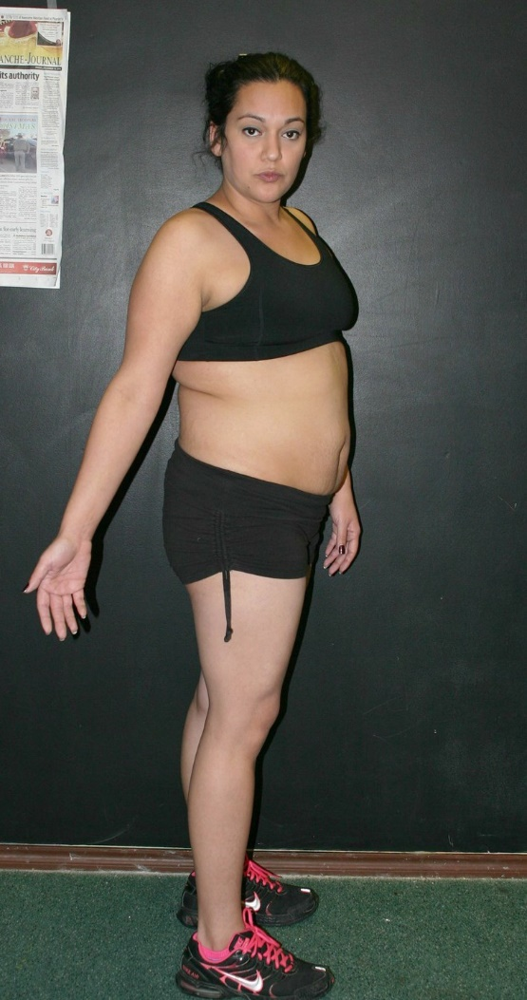
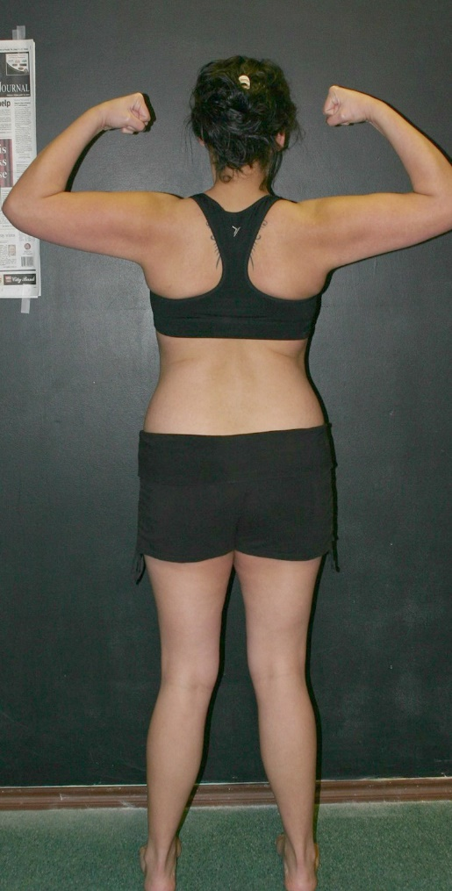
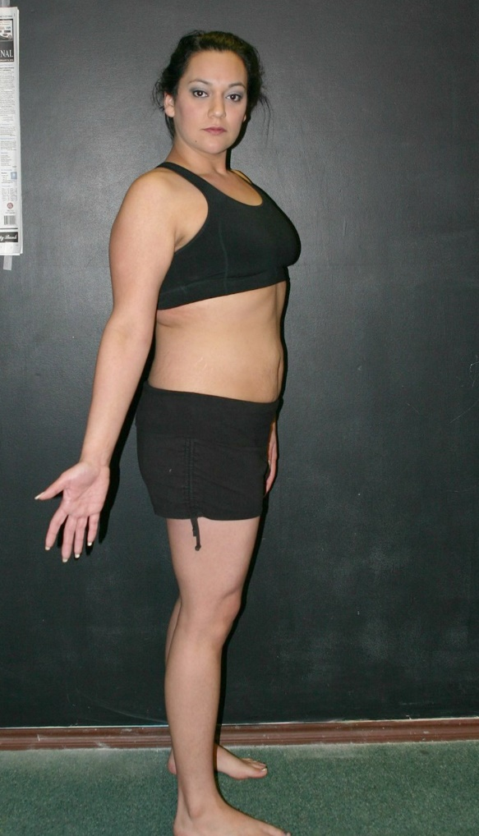
SAMANTHA
MORENO 3RD PLACE
BEST FEMALE
TRAMSFORMATION
Weight-Loss Claimer: Consumers who use Herbalife® Formula 1 twice per day as part of a healthy lifestyle can generally expect to lose around 0.5 to 1 pound per week. Participants in a 12-week, single-blind study used Formula 1 twice per day (once as a meal and once as a snack) with a reduced- calorie diet and a goal of 30 minutes of exercise per day. Participants followed either a high-protein diet or a standard protein diet. Participants in both groups lost about 8.5 pounds.

Slide 25
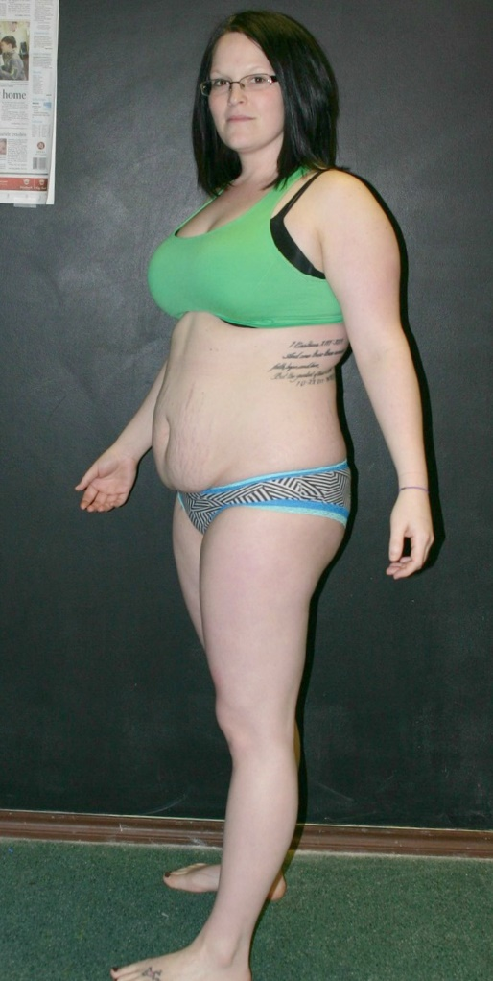
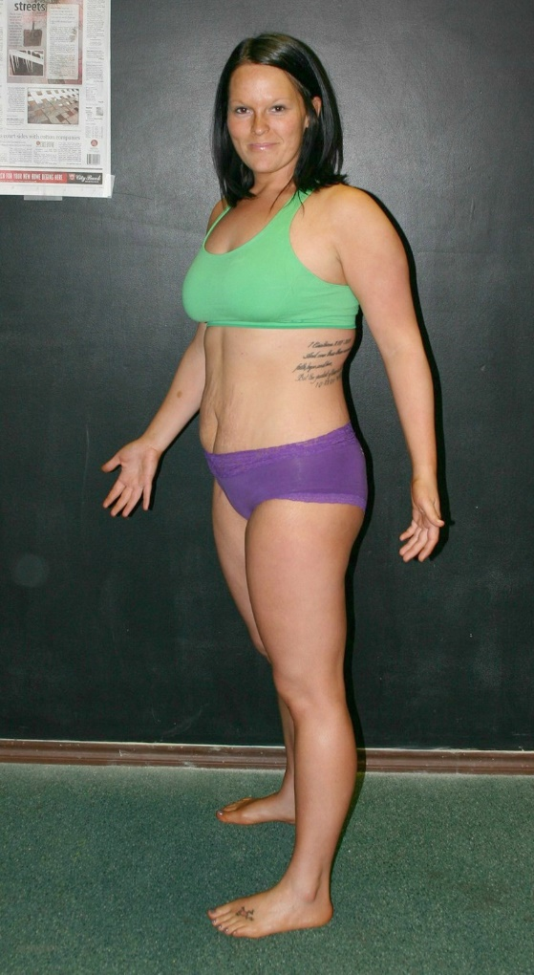
MIKKA MILLER 2ND PLACE
BEST FEMALE
TRAMSFORMATION
Weight-Loss Claimer: Consumers who use Herbalife® Formula 1 twice per day as part of a healthy lifestyle can generally expect to lose around 0.5 to 1 pound per week. Participants in a 12-week, single-blind study used Formula 1 twice per day (once as a meal and once as a snack) with a reduced- calorie diet and a goal of 30 minutes of exercise per day. Participants followed either a high-protein diet or a standard protein diet. Participants in both groups lost about 8.5 pounds.

Slide 26
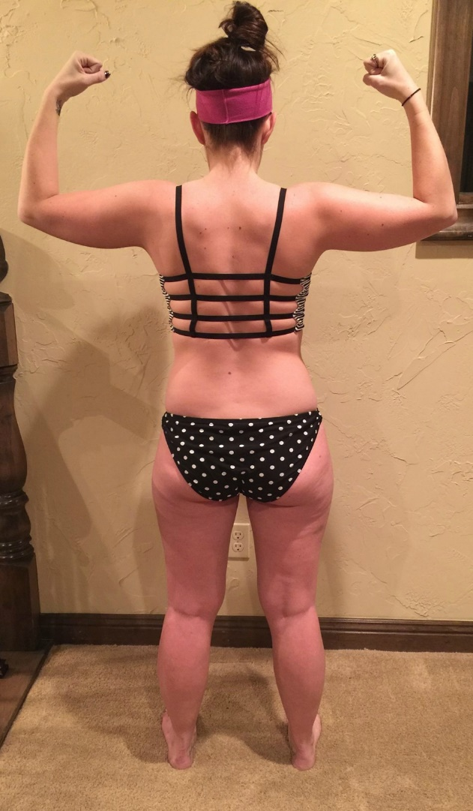
KRISTIN BOND
1ST PLACE
BEST FEMALE
TRAMSFORMATION
Weight-Loss Claimer: Consumers who use Herbalife® Formula 1 twice per day as part of a healthy lifestyle can generally expect to lose around 0.5 to 1 pound per week. Participants in a 12-week, single-blind study used Formula 1 twice per day (once as a meal and once as a snack) with a reduced- calorie diet and a goal of 30 minutes of exercise per day. Participants followed either a high-protein diet or a standard protein diet. Participants in both groups lost about 8.5 pounds.

Slide 27
BTC - MARCH 2015
MALE TRANSFORMATION

Slide 28
HONORABLE MENTION – MALE TRANSFORMATION
JACOB RAMOS: WEIGHT LOSS % - 7.05%
18.80 LBS. BODY FAT LOSS – 1.00%
RICARDO FLORES: WEIGHT LOSS % - 8.25%
16.60 LBS. BODY FAT LOSS – 4.50%
Weight-Loss Claimer: Consumers who use Herbalife® Formula 1 twice per day as part of a healthy lifestyle can generally expect to lose around 0.5 to 1 pound per week. Participants in a 12-week, single-blind study used Formula 1 twice per day (once as a meal and once as a snack) with a reduced- calorie diet and a goal of 30 minutes of exercise per day. Participants followed either a high-protein diet or a standard protein diet. Participants in both groups lost about 8.5 pounds.

Slide 29
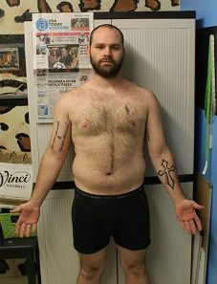
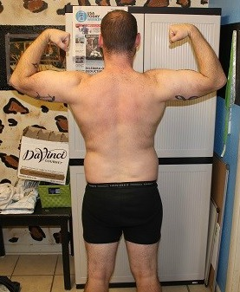
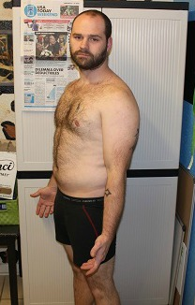
RUSTON
SCARBROUGH
3RD PLACE
BEST MALE
TRAMSFORMATION
Weight-Loss Claimer: Consumers who use Herbalife® Formula 1 twice per day as part of a healthy lifestyle can generally expect to lose around 0.5 to 1 pound per week. Participants in a 12-week, single-blind study used Formula 1 twice per day (once as a meal and once as a snack) with a reduced- calorie diet and a goal of 30 minutes of exercise per day. Participants followed either a high-protein diet or a standard protein diet. Participants in both groups lost about 8.5 pounds.

Slide 30
CHUCKIE
CASTILLO
2ND PLACE
BEST MALE
TRAMSFORMATION
Weight-Loss Claimer: Consumers who use Herbalife® Formula 1 twice per day as part of a healthy lifestyle can generally expect to lose around 0.5 to 1 pound per week. Participants in a 12-week, single-blind study used Formula 1 twice per day (once as a meal and once as a snack) with a reduced- calorie diet and a goal of 30 minutes of exercise per day. Participants followed either a high-protein diet or a standard protein diet. Participants in both groups lost about 8.5 pounds.

Slide 31
SPENCER
BRAZIEL 1ST PLACE
BEST MALE
TRAMSFORMATION
Weight-Loss Claimer: Consumers who use Herbalife® Formula 1 twice per day as part of a healthy lifestyle can generally expect to lose around 0.5 to 1 pound per week. Participants in a 12-week, single-blind study used Formula 1 twice per day (once as a meal and once as a snack) with a reduced- calorie diet and a goal of 30 minutes of exercise per day. Participants followed either a high-protein diet or a standard protein diet. Participants in both groups lost about 8.5 pounds.

Slide 32
BTC MARCH 2015
FEMALE – BODY SCULPTING

Slide 33
HONORABLE MENTION – FEMALE BODY SCULPTING
CHANNING IVERSON – WEIGHT LOSS % - 5.11% 6.20LBS. BODY FAT LOSS – .90%
ABBY HARRISON – WEIGHT LOSS % - 1.84%
2.40 LBS. BODY FAT LOSS – 6.40%
Weight-Loss Claimer: Consumers who use Herbalife® Formula 1 twice per day as part of a healthy lifestyle can generally expect to lose around 0.5 to 1 pound per week. Participants in a 12-week, single-blind study used Formula 1 twice per day (once as a meal and once as a snack) with a reduced- calorie diet and a goal of 30 minutes of exercise per day. Participants followed either a high-protein diet or a standard protein diet. Participants in both groups lost about 8.5 pounds.

Slide 34
KALEY
MOORE
3RD PLACE
FEMALE
BODY SCULPTING
Weight-Loss Claimer: Consumers who use Herbalife® Formula 1 twice per day as part of a healthy lifestyle can generally expect to lose around 0.5 to 1 pound per week. Participants in a 12-week, single-blind study used Formula 1 twice per day (once as a meal and once as a snack) with a reduced- calorie diet and a goal of 30 minutes of exercise per day. Participants followed either a high-protein diet or a standard protein diet. Participants in both groups lost about 8.5 pounds.

Slide 35
MINDY FLORES
2ND PLACE
FEMALE
BODY SCULPTING
Weight-Loss Claimer: Consumers who use Herbalife® Formula 1 twice per day as part of a healthy lifestyle can generally expect to lose around 0.5 to 1 pound per week. Participants in a 12-week, single-blind study used Formula 1 twice per day (once as a meal and once as a snack) with a reduced- calorie diet and a goal of 30 minutes of exercise per day. Participants followed either a high-protein diet or a standard protein diet. Participants in both groups lost about 8.5 pounds.

Slide 36
SHELBY BANDA 1ST PLACE
FEMALE
BODY SCULPTING
Weight-Loss Claimer: Consumers who use Herbalife® Formula 1 twice per day as part of a healthy lifestyle can generally expect to lose around 0.5 to 1 pound per week. Participants in a 12-week, single-blind study used Formula 1 twice per day (once as a meal and once as a snack) with a reduced- calorie diet and a goal of 30 minutes of exercise per day. Participants followed either a high-protein diet or a standard protein diet. Participants in both groups lost about 8.5 pounds.

Slide 37
BTC - MARCH 2015
MALE – MUSCLE DEFINITION

Slide 38
HONORABLE MENTION – MALE MUSCLE DEFINATION
ALEX BANDA – WEIGHT LOSS % -.57% -1.00 LBS. BODY FAT LOSS – 7.30%
J.T. FIELDS– WEIGHT LOSS % - 1.13%
-1.60 LBS. BODY FAT LOSS – 2.90%
Weight-Loss Claimer: Consumers who use Herbalife® Formula 1 twice per day as part of a healthy lifestyle can generally expect to lose around 0.5 to 1 pound per week. Participants in a 12-week, single-blind study used Formula 1 twice per day (once as a meal and once as a snack) with a reduced- calorie diet and a goal of 30 minutes of exercise per day. Participants followed either a high-protein diet or a standard protein diet. Participants in both groups lost about 8.5 pounds.

Slide 39
HAROLD CROW 3RD PLACE
MALE MUSCLE DEFINITION
Weight-Loss Claimer: Consumers who use Herbalife® Formula 1 twice per day as part of a healthy lifestyle can generally expect to lose around 0.5 to 1 pound per week. Participants in a 12-week, single-blind study used Formula 1 twice per day (once as a meal and once as a snack) with a reduced- calorie diet and a goal of 30 minutes of exercise per day. Participants followed either a high-protein diet or a standard protein diet. Participants in both groups lost about 8.5 pounds.

Slide 40
CORY GRAY 2ND PLACE
MALE MUSCLE DEFINITION
Weight-Loss Claimer: Consumers who use Herbalife® Formula 1 twice per day as part of a healthy lifestyle can generally expect to lose around 0.5 to 1 pound per week. Participants in a 12-week, single-blind study used Formula 1 twice per day (once as a meal and once as a snack) with a reduced- calorie diet and a goal of 30 minutes of exercise per day. Participants followed either a high-protein diet or a standard protein diet. Participants in both groups lost about 8.5 pounds.

Slide 41
KNIGIAN BELL 1ST PLACE
MALE MUSCLE DEFINATION
Weight-Loss Claimer: Consumers who use Herbalife® Formula 1 twice per day as part of a healthy lifestyle can generally expect to lose around 0.5 to 1 pound per week. Participants in a 12-week, single-blind study used Formula 1 twice per day (once as a meal and once as a snack) with a reduced- calorie diet and a goal of 30 minutes of exercise per day. Participants followed either a high-protein diet or a standard protein diet. Participants in both groups lost about 8.5 pounds.

Slide 42
BTC - MARCH 2015
GRAND CHAMPION!!

Slide 43
KIM
WHITEHEAD
BEFORE
Weight-Loss Claimer: Consumers who use Herbalife® Formula 1 twice per day as part of a healthy lifestyle can generally expect to lose around 0.5 to 1 pound per week. Participants in a 12-week, single-blind study used Formula 1 twice per day (once as a meal and once as a snack) with a reduced- calorie diet and a goal of 30 minutes of exercise per day. Participants followed either a high-protein diet or a standard protein diet. Participants in both groups lost about 8.5 pounds.

Slide 44
WOW
KIM WHITEHEAD
AFTER!!!!
Weight-Loss Claimer: Consumers who use Herbalife® Formula 1 twice per day as part of a healthy lifestyle can generally expect to lose around 0.5 to 1 pound per week. Participants in a 12-week, single-blind study used Formula 1 twice per day (once as a meal and once as a snack) with a reduced- calorie diet and a goal of 30 minutes of exercise per day. Participants followed either a high-protein diet or a standard protein diet. Participants in both groups lost about 8.5 pounds.

Slide 45
KIM
WHITEHEAD
LOST
24.20 LBS
12.30% BF
WEIGHT LOSS %
Weight-Loss Claimer: Consumers who use Herbalife® Formula 1 twice per day as part of a healthy lifestyle can generally expect to lose around 0.5 to 1 pound per week. Participants in a 12-week, single-blind study used Formula 1 twice per day (once as a meal and once as a snack) with a reduced- calorie diet and a goal of 30 minutes of exercise per day. Participants followed either a high-protein diet or a standard protein diet. Participants in both groups lost about 8.5 pounds.

